Slide 1

LOW POWER TRANSMISSION USING LORA TECHNOLOGY
TEAM MEMBERS : E.G.PRADEEP (RA2211004050026) B.PRASANTH (RA2211004050008)
Guided by, DR.M.MATHAN KUMAR DEP OF ECE

Slide 2
INTRODUCTION
A LoRaWAN network (Long Range Network Protocol) is of the Low Power Wide Area Network (LPWAN) type and encompasses battery powered devices that ensure bidirectional communication. The main contribution of the project is the evaluation of the LoRa technology considering the requirements of Low powered Communication.

Slide 3
PROBLEM STATEMENT
⇒Conventional wireless modules are limited by short range, high power consumption, or reliance on cellular infrastructure.
⇒Ensuring Low Power Consumption during data transmission and idle modes is critical for battery-powered STM32-LoRa sensor nodes.
⇒Establishing a reliable SPI-based interface between STM32 and SX1276 LoRa module.

Slide 4
LITERACY SURVEY
S. No | Title of the Paper | Author(s) | Year | Key Focus / Contribution | Outcome / Relevance
1 | Low-Power, Long-Range, High-Data Transmission Using Wi-Fi and LoRa | D. H. Kim, J. Y. Lim, J. D. Kim | 2016 | Integration of Wi-Fi and LoRa for improved coverage and data rate | Demonstrates low power and high data transmission—relevant for hybrid applications with STM32
2 | A Study of LoRa Low Power and Wide Area Network Technology | U. Noreen, A. Bounceur, L. Clavier | 2017 | Technical analysis of LoRa’s range and energy efficiency | Useful for selecting parameters in STM32-LoRa interface
3 | Tracking and Monitoring System for Lightweight Boats | R. Sanchez-Iborra, G. Liaño, I. Simoes, C. Couñago, E. Skarmeta | 2018 | Real-time LoRa monitoring system for boats | Enhances STM32 project applications like tracking and environment monitoring
4 | Matching-Driven Deep Reinforcement Learning for Energy-Efficient Transmission Parameter Allocation in Multi-Gateway LoRa Networks | Ziqi Lin, Xu Zhang, Shimin Gong, Lanhua Li, Zhou Su, Bo Gu | 2023 | Deep RL for optimizing transmission parameters | AI-based optimization applicable to STM32-based LoRa systems
5 | Matching-Driven Deep Reinforcement Learning for Energy-Efficient Transmission Parameter Allocation in Multi-Gateway LoRa Networks | Ziqi Lin, Xu Zhang, Shimin Gong, Lanhua Li, Zhou Su, Bo Gu | 2024 | Improved version of the 2023 model | Reinforces intelligent transmission management in STM32-LoRa design
6 | LoRa Backscatter Communications: Temporal, Spectral, and Error Performance Analysis | Ganghui Lin, Ahmed Elzanaty, Mohamed-Slim Alouini | 2023 | Backscatter transmission evaluation | Alternative low-power approach suitable for STM32 deployment
7 | Energy Efficient Transmission Parameters Selection Method Using Reinforcement Learning in Distributed LoRa Networks | Ryotai Airiyoshi, Mikio Hasegawa, Tomoaki Ohtsuki, Aohan Li | 2024–2025 | RL-based optimization in distributed LoRa networks | Supports use of distributed, energy-aware STM32-based LoRa networks
8 | An Ultra Low Power LoRa Mesh for Low Cost and Real Time Resort Pool Temperature Monitoring | Jesse Duran, Yiyan Li | 2023 | Real-time LoRa mesh monitoring application | Demonstrates practical use of ultra-low power mesh with LoRa on STM32
9 | Performance Assessment of a Low Power Wide Area Wireless Network Based on LoRa Technology Using IoT Devices in Different Bolivia Areas | Eynar Calle Viles et al. | 2024 | Real-world performance of LoRa in diverse environments | Helps assess STM32-LoRa network behavior under various geographical conditions
10 | Research on Real-Time Data Wireless Communication System Based on LoRa Technology | Diyuan Shen, Ling Huang, Xiaobo Zhang, Zhangqin Huang | 2024 | Real-time wireless data communication system using LoRa | Validates the STM32-LoRa system’s goal of real-time transmission

Slide 5
LITERACY GAP
S.No | Identified Gap | Explanation
1 | Lack of Integration with STM32 Microcontrollers | Most studies focused on LoRa technology, energy efficiency, or communication protocols but did not explore specific hardware-level interfacing with STM32 MCUs.
2 | Limited Real-Time Applications with Specific Use-Cases | While some papers discussed LoRa applications (e.g., boat tracking, pool monitoring), few implemented real-time environmental sensing with LoRa and STM32 together.
3 | Absence of Combined Evaluation for Power + Performance on STM32 + LoRa | No paper offered a holistic analysis of both low power consumption and reliable data transmission when interfacing LoRa SX1276 with STM32.
4 | No Specific Focus on SX1276 915 MHz Configuration | Although LoRa is discussed broadly, specific frequency bands like 915 MHz in SX1276 with STM32-based setups were not detailed in any reviewed work.
5 | Insufficient Hardware Implementation Studies | Several works used simulations or general theoretical models, with limited practical or prototype-level implementations involving STM32 and LoRa SX1276.
6 | Neglect of Interfacing Protocol Optimization | There is limited discussion on optimizing SPI or GPIO protocols for STM32–LoRa interfacing to achieve efficient communication and control.

Slide 6
MOTIVATION BEHIND
⇒Low-power, long-range wireless communication is essential for scalable, battery-operated IoT networks.
⇒LoRa SX1276 enables sub-GHz communication with minimal power, making it ideal for remote and unattended sensor nodes.
⇒Optimized LoRa-SX1276 interfacing techniques are needed to reduce active transmission time and extend battery life.

Slide 7
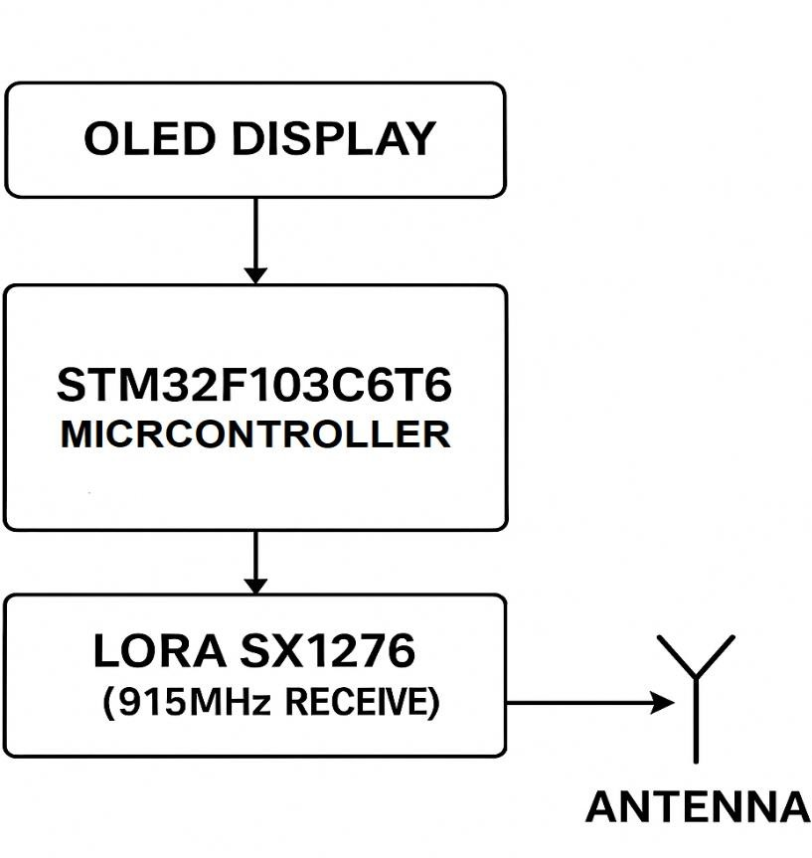
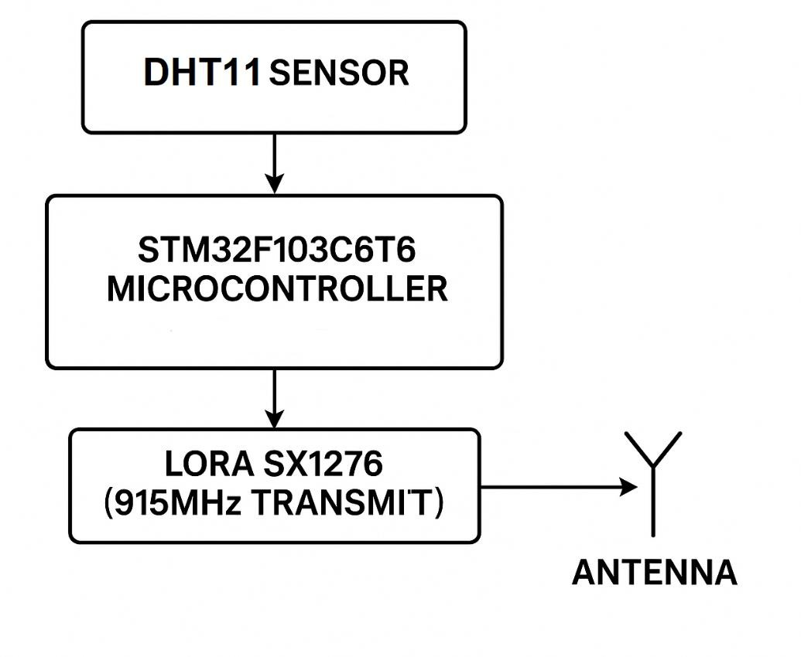
BLOCK DIAGRAM

Slide 8
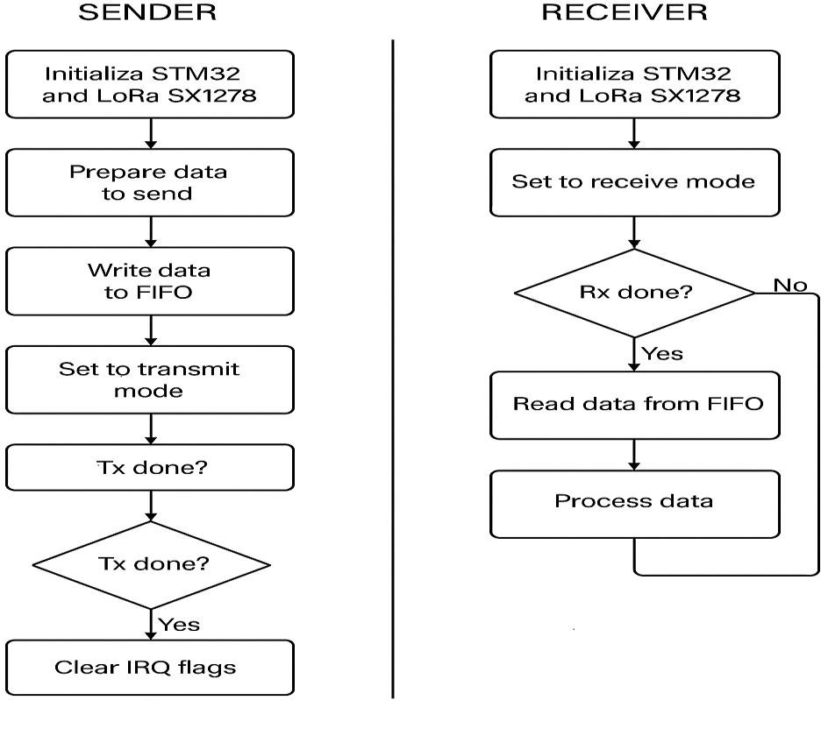
ALGORITHM

Slide 9
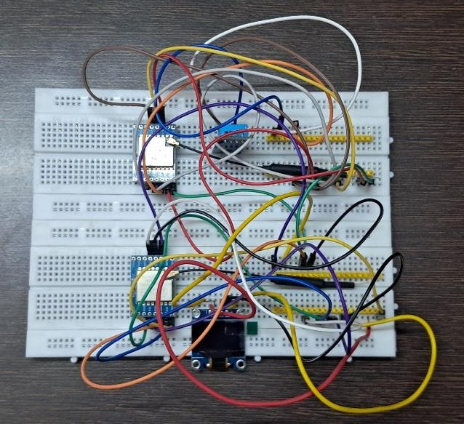
PROTOTYPE HARDWARE

Slide 10
CONCLUSION
The successful interfacing of the LoRa SX1276 with the STM32 microcontroller using the LR1276-915MHz module demonstrates an efficient solution for low-power long-range wireless communication. The implementation achieves a balance between power efficiency, communication reliability, and hardware simplicity, making it suitable for IoT and remote monitoring applications. Simulation and real-time testing validate the system’s effectiveness in transmitting sensor data over extended distances.

Slide 11
REFERENCES
1.D. H. Kim, J. Y. Lim and J. D. Kim,“Low-Power, Long-Range, High-Data Transmission Using Wi-Fi and LoRa”, 6th International Conference on IT Convergence and Security (ICITCS), Prague, Czech Republic, 2016, pp. 1-3,
DOI: 10.1109/ICITCS.2016.7740351.
2. U. Noreen, A. Bounceur and L. Clavier, “A study of LoRa low power and wide area network technology”, International Conference on Advanced Technologies for Signal and Image Processing (ATSIP), Fez, Morocco,pp. 1-6, DOI: 10.1109/ATSIP.2017.8075570.
3.Sanchez-Iborra, R., G. Liaño, I., Simoes, C., Couñago, E.,& Skarmeta, A. F. . ,“Tracking and monitoring system basedon LoRa technology for lightweight boats”.December 2018.Electronics 8(1):15DOI: 10.3390/electronics8010015LicenseCC BY 4.0
4.Ziqi Lin, Xu Zhang, Shimin Gong, Lanhua Li, Zhou Su, Bo Gu,“Matching-Driven Deep Reinforcement Learning for Energy-Efficient Transmission Parameter Allocation in Multi-Gateway LoRa Networks”.From: Xu Zhang [view email] [v1] Sat, 16 Sep 2023 11:37:23 UTC (2,953 KB)
5.Ziqi Lin, Xu Zhang, Shimin Gong, Lanhua Li, Zhou Su, Bo Gu,“Matching-Driven Deep Reinforcement Learning for Energy-Efficient Transmission Parameter Allocation in Multi-Gateway LoRa Networks”.From: Ziqi Lin [view email] [v1] Thu, 18 Jul 2024 00:54:26 UTC (2,126 KB)

Slide 12
REFERENCES
6.Ganghui Lin, Ahmed Elzanaty, Mohamed-Slim Alouini,“LoRa Backscatter Communications: Temporal, Spectral, and Error Performance Analysis”.From: Ganghui Lin [view email] [v1] Sun, 4 Jun 2023 10:30:04 UTC (8,299 KB) [v2] Tue, 20 Jun 2023 14:33:44 UTC (8,323 KB)
7.Ryotai Airiyoshi, Mikio Hasegawa, Tomoaki Ohtsuki, Aohan Li,“Energy Efficient Transmission Parameters Selection Method Using Reinforcement Learning in Distributed LoRa Networks)”.From: Aohan Li [view email] [v1] Tue, 15 Oct 2024 04:49:56 UTC (2,355 KB) [v2] Wed, 22 Jan 2025 04:25:10 UTC (2,354 KB)
8.Jesse Duran;Yiyan Li,“An Ultra Low Power LoRa Mesh for Low Cost and Real Time Resort Pool Temperature Monitoring”.DOI:10.1109/ICETCI57876.2023.10177034
9.Eynar Calle Viles; Edgar Roberto Ramos Silvestre; Elias Brayan Choque Maydana; Wilder Orellana Lopez; Cristian Capriles Olivera,“Performance Assessment of a Low Power Wide Area wireless Networks based on Lora Technology using IOT devices in different Bolivia Areas ”.DOI:10.1109/ETCM63562.2024.10746217
10.Diyuan Shen;Ling Huang;Xiaobo Zhang;Zhangqin Huang,“Research on ReaL Time Data Wireless Communication System Based on LoRa Technology”.DOI:10.1109/ICCCS61882.2024.10602933

Slide 13
THANK YOU !

